Slide 1


ELVION | Smarter IT. Seamless Service.
Elvion is a modern ITSM company helping businesses streamline operations through intelligent automation, rapid incident response, and data-driven service strategies.
We empower your IT teams to deliver faster, smarter support—at scale.

Slide 2




Core Services
IT Service Management
AI-Powered Automation
24/7 Helpline & Support
Incident & Problem Management, Change & Release Management, Configuration & Asset Tracking, SLA Monitoring & Reporting
Workflow automation, Predictive issue resolution, Chatbot-assisted support
Multi-channel support, Escalation protocols, Knowledge base integration

Slide 3





Why Choose Elvion?
Modern, cloud-first tools
Built with automation at the core
Custom-tailored solutions
Designed for your specific needs
Lightning-fast response times
Minimize downtime and disruption
Scalable to your business size
Grows as your company evolves

Slide 4





Our Process
Discovery & Audit
Assess current systems and needs
Solution Mapping
Design tailored ITSM strategy
System Setup
Implement and integrate solutions
Testing & Optimization
Refine for peak performance
Ongoing Support
Continuous monitoring and improvement

Slide 5
Industries We Serve
Healthcare
Finance
Education
Secure patient data management and streamlined clinical workflows
Compliant systems with high-security protocols and minimal downtime
Scalable solutions supporting diverse campus technology needs
Enterprise & SMBs
Retail & E-commerce
Customized IT support that grows with your business
Reliable systems ensuring seamless customer experiences

Slide 6
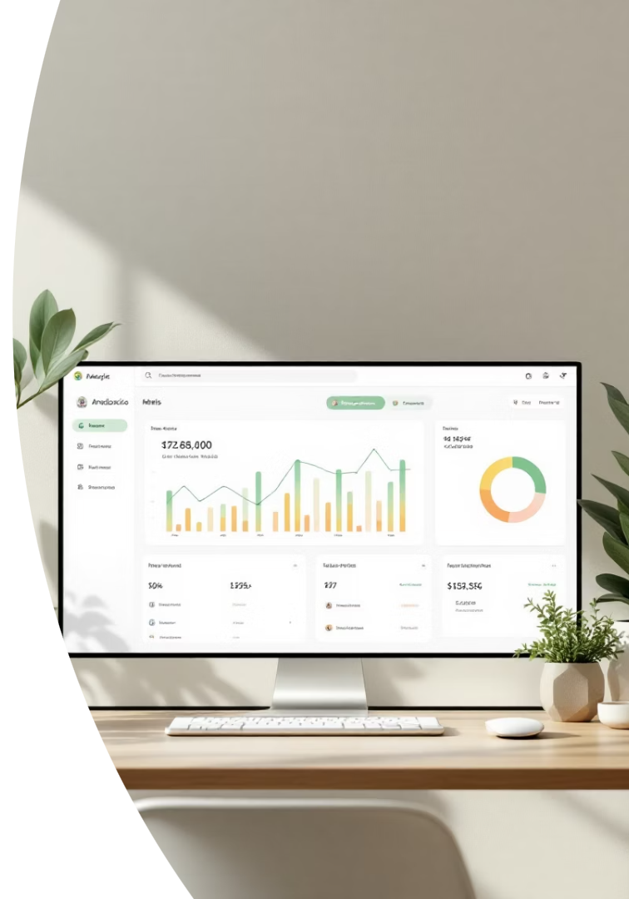
Success Metrics
40%
Faster Resolution
Quicker ticket resolution times
99.9%
Uptime
Consistent system availability
65%
Fewer Escalations
Reduced need for higher-level intervention
2x
Satisfaction
Doubled user satisfaction ratings

Slide 7
Let's Talk
Contact Information
Next Steps
Email: info@elvion.ca
Book a free consultation to discover how Elvion can transform your IT service management.
Web: www.elvion.ca
Our team will analyze your current systems and propose tailored solutions.
Location: Toronto, Canada

